Slide 1

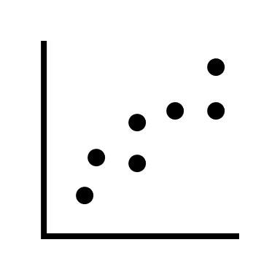


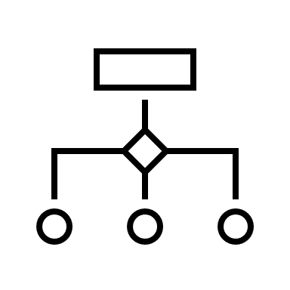
Anatomy of a Research Poster
Name 1, Name 2, Name 3
BACKGROUND
RESULTS
OTHER CONSIDERATIONS
Explain why the study matters in simple terms. What health challenges prompted this work? Why are you investigating this question?
Your findings should take up the majority of the space. The more you are able to use plain English, the wider an audience you can reach!
Distill the key ideas. What did you discover? What are the results and what are their impact?
What do these findings mean for patients, your population of interest, health care providers, the health system, or the broader field of study?
Any other results, graphs, tables, or nuance you can’t capture with the main findings can have the remainder of the space.
Anything worth discussion about future directions? Limitations? Any other considerations about this work?
METHODS
Include your study population/sample, brief method collection, and what processes you used for analysis. Add a flowchart or visualization if possible.
You don’t need to include every detail. Be concise.
Visualize findings with an image, graph, or figure.
Help people navigate your ideas by avoiding visually crowded posters and only speaking to the most essential points.
Add references, affiliations/partners, extra logos, acknowledgements, contact information, etc. at the bottom.

Slide 2
TIPS & FAQs
This is a 4’ x 3’ poster when printed. Font sizes below 32pt will be difficult to read when printed!
Use QR codes to link out to full publications, your website, or contact information. Generate one for free at QR Code Generator by Bitly.
Not every graph/chart from your analysis needs to be included – select the most relevant that convey the key findings
If you find your content is overflowing the recommended space, do not decrease font size – your audience will not stop to read more. Find the key points and CUT the remainder.
Tight and long blocks of text impede readability. Don’t try to fill all white space, give your content some breathing room so the audience can easily understand how to move from one segment to the next.
Check out Creating an Academic Poster: Tips and Tricks for recommendations on content structure, font sizes, and how to effectively present and incorporate visuals such as charts and diagrams.

Slide 3



